Slide 1

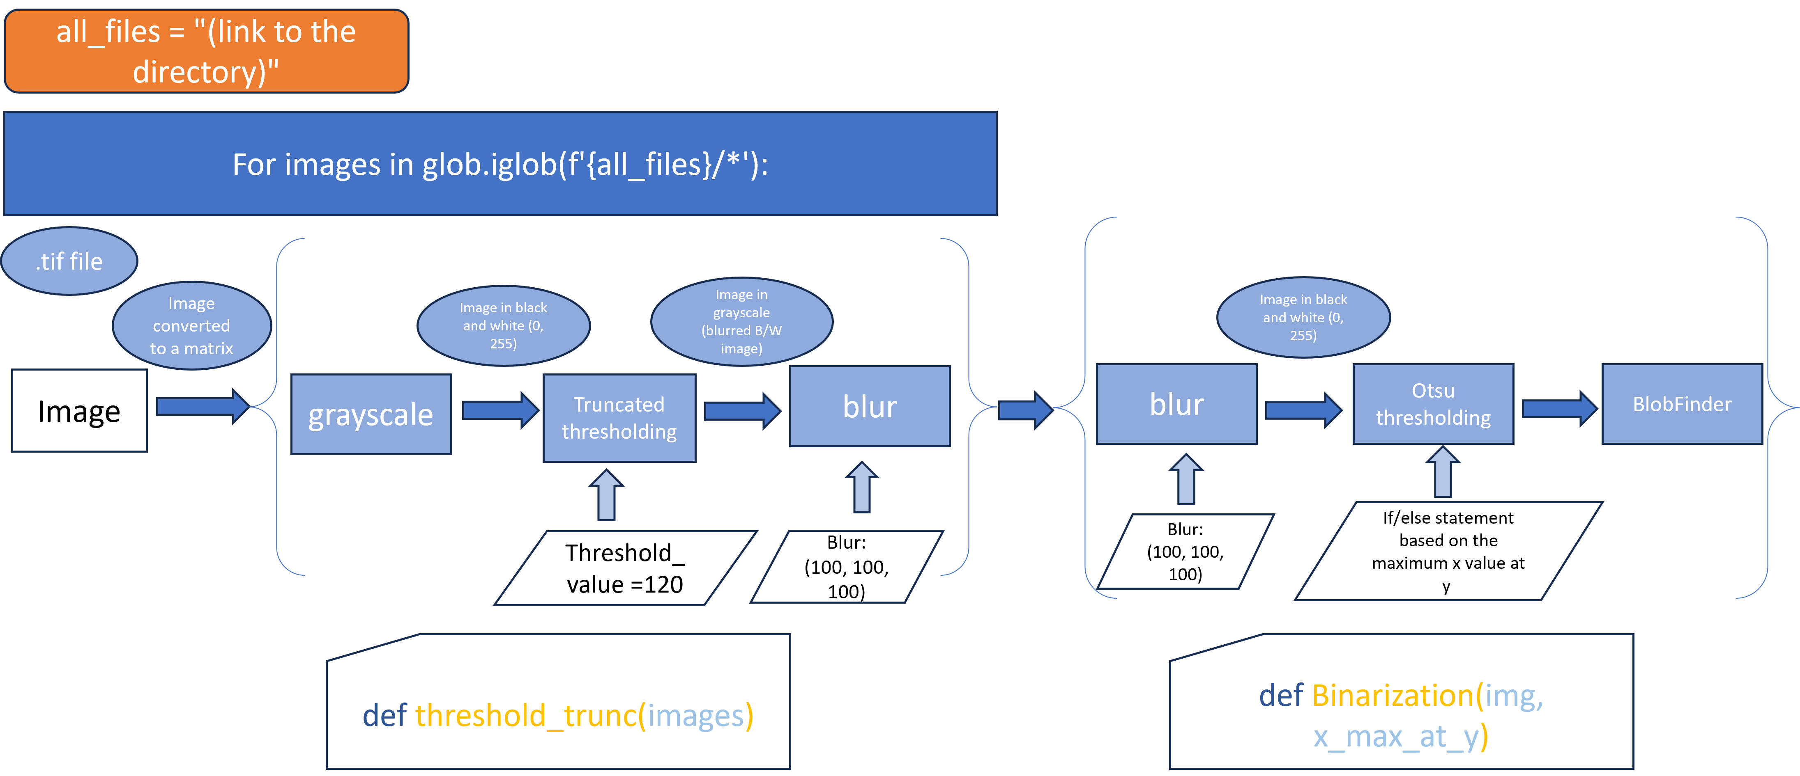
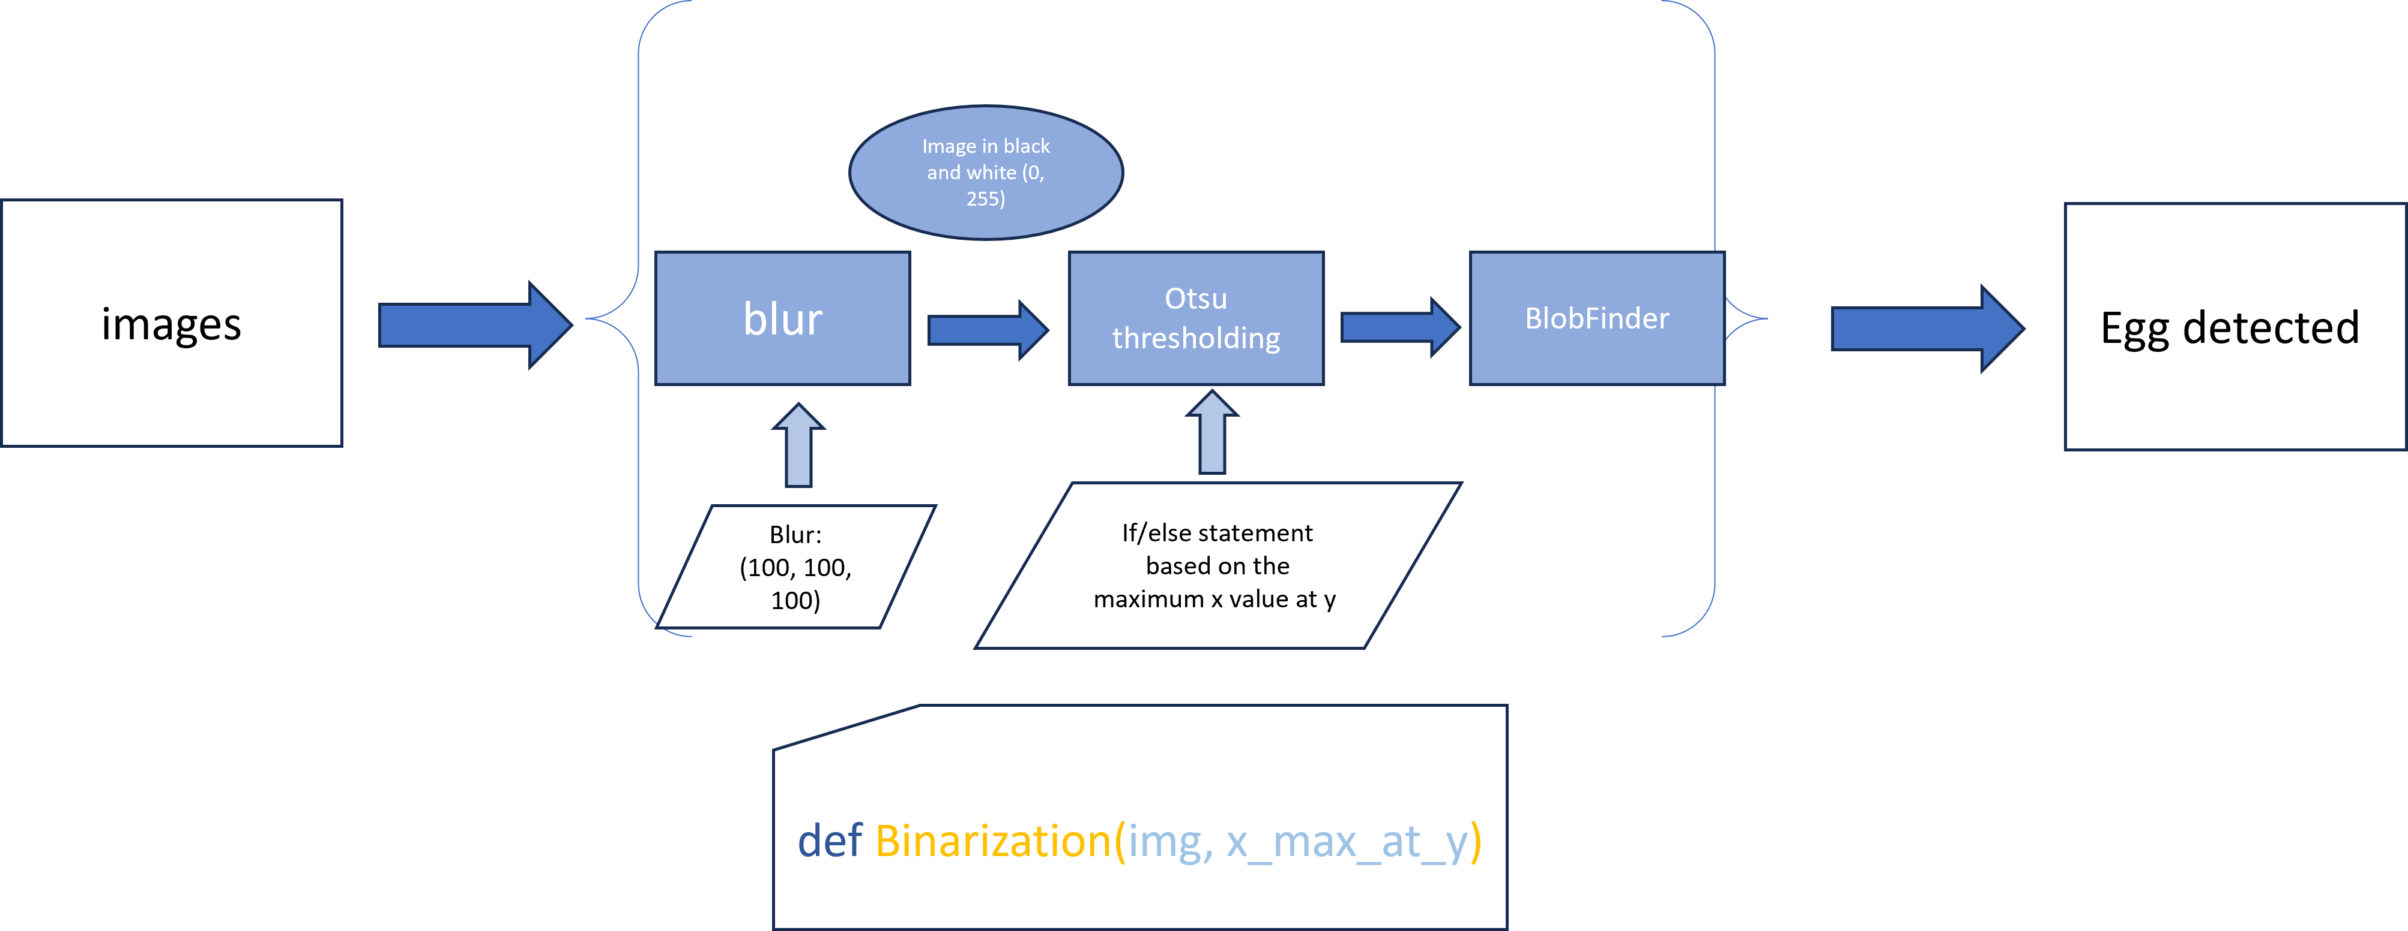
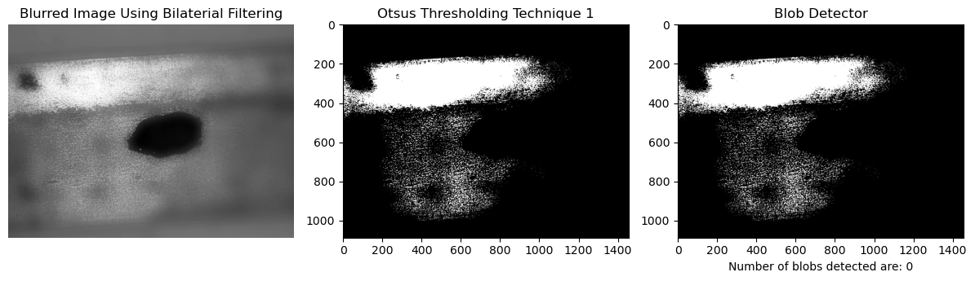

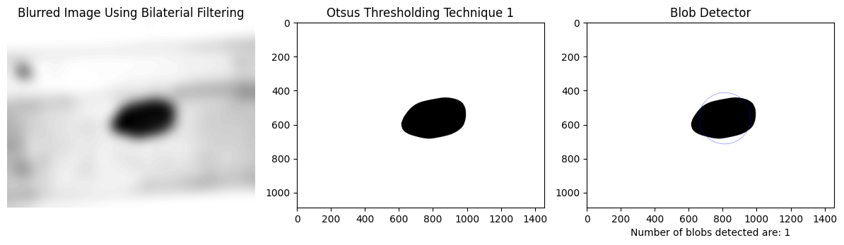


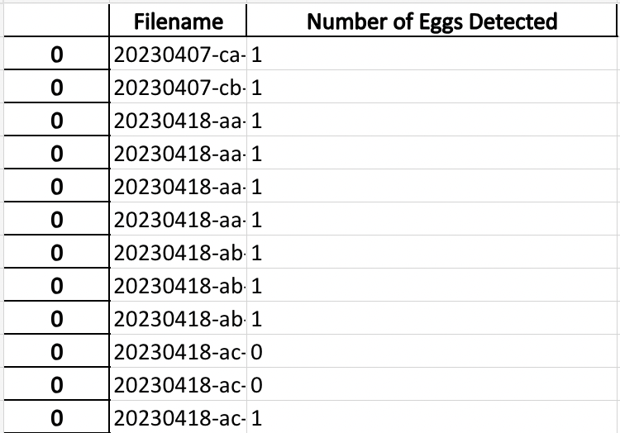
Combatting the Invasive Spotted Lanternfly with Blob Detection
Annette Kroes, Dr. Maureen Tang, Karla Negrete
Drexel University, Department of Chemical and Biological Engineering
​
The original code prior to my edits performed the Binarization and BlobDetector functions on images that were loaded into the code and named.
The original code also had issues with the binarization step in the process, which in turn prevented the BlobDetector from working properly.
Introduction
Data and Results
Conclusion
The Spotted Lanternfly (Lycorma delicatula) is an invasive insect currently occupying the Mid-Atlantic United States. With no natural predators, the Spotted Lanternfly poses a threat to various tree species and even some crops (aphis.usda.gov). Lanternflies can lay egg masses on train cars, under trucks, and on storage crates, which allows for the rapid spread of the pest across state lines.
This project seeks to develop an image processing algorithm that can automatically detect egg masses in those spaces where humans themselves often cannot safely go. The project has taken many different forms since its' conception, but in its current state strives to develop an algorithm that:
Recognizes Lanternfly egg masses successfully and ignores non-eggs
Exports the results to an Excel sheet for easy access
Can potentially be integrated into a camera device that can be used by transportation companies
The final leg of the research was spent analyzing the Excel sheet to determine the code's success. The code boasts roughly 61% success at correctly identifying blobs and correctly counting them. OpenCv's SimpleBlobDetector does effectively seek and identify blobs in an image, though it is to be discovered if a different image processing software might have more success. Overall, the g
Future Work
Moving forward, the project could benefit from looking into the features of other image processing software. Scikit-Image, or Skimage, also possesses a blob detection program that could not be investigated during this research for the sake of time.
Furthermore, more research into the egg masses themselves could be done to advance the project. Egg mass area, color, and circularity are similar enough between masses and this could suggest a trend that could be useful. It could be lucrative to find averages for all of these features and use those numbers to set blob detection parameters.
Methods
Python was the program used to write and run the code for the algorithm. We ran Python 3.9.16 in Visual Studio Code.
The features of the code rely on the functions within the packages downloaded from the following libraries:
cv2
numpy
matplotlib.pyplot
glob
os
Pandas
Openpyxl
The final code contains a "for loop", a feature in Python code that iterates through a directory of images to perform a set of functions on those images.
The final code also includes a second binarization function that features truncated thresholding.
Acknowledgements
The last step of the loop exports the results of the experiment into an Excel sheet for easier viewing and analyzing. The sheet displays the filename and the number of blobs detected. This is an important feature of the automation process because it eliminates the need for a person to look through the images themselves, instead easily notifying a reader of which images have eggs and which do not.
I'd like to extend a huge thank you to the entire Tang lab for being so welcoming and offering insight/help throughout the summer.
I also would like to thank Maureen Tang for being an excellent mentor and for welcoming me into this project, and Karla Negrete, who sat with me for hours debugging code on top of everything else she did as a mentor. It was an amazing experience to work with the both of you!
Lastly, I'd like to acknowledge and thank the capstone group that began this project, and anyone who might contribute to it in the future.
References
Will be entered once poster is final.
Notes:
Introduction: The Spotted Lanternfly (Lycorma delicatula) is an invasive insect currently occupying the Mid-Atlantic United States. With no natural predators, the Spotted Lanternfly poses a threat to various tree species and even some crops (aphis.usda.gov). Lanternflies can lay egg masses on train cars, under trucks, and on storage crates, which allows for the rapid spread of the pest across state lines.
It's assumed that the lanternfly entered the US via some sort of storage crate, and although preventative measures have been put in place, lanternflies are still able to hitchhike across the US in the same fashion. Not all eggs are laid in places that workers are able to safely go to remove them—which is a problem that inspired this project's conception: can we develop some sort of device that can reliably and accurately detect egg masses?
This project seeks to develop an image processing algorithm that can automatically detect egg masses in those spaces where humans themselves often cannot safely go. Through a combination of a loop that iterates through our sample images in a database, some blurring and thresholding features, and a blobfinder function created using Cv2's SimpleBlobDetector, the end result should ideally recognize egg masses, export the results to an excel sheet, and have the long term potential to be integrated into a device that can be used to solve the issue outlined earlier.
Data and Results:
The original code prior to my edits performed the Binarization and BlobDetector functions on images that were loaded into the code and named. These functions were written by my mentor, Karla, and still exist in the final form of the code. An issue with the code in this state that I was tasked to solve was that images had to be imported into the code, assigned a variable, and then the code would be able to perform the binarization and blob detection on the images. The issue with this is that we had a lot of sample images, and if somebody had to come in and manually define each image, it would defeat the purpose of automating the egg detection process entirely. The second issue with the code had something to do with the thresholding step. Ideally, the goal of the binarization function is to convert the image from a grayscale picture into a white screen with only the blobs in black. This is determined by an if/else statement: if the x value at y's maximum is above a certain value, then all pixels below that value will be black (0) and all pixels above that value will be white (255). Then, the BlobDetector function would identify blobs as egg masses depending on a number of parameters that are preset. The thresholding methods that were being used were producing a fuzzy image rather than the results that we needed. This was the second issue I needed to research and fix.
The first edit to the code I made was to integrate each function into a for loop that worked like this. (point to dark blue block and go through the process like a loop). For every image in the directory I assign to the code, perform each of these steps. At the end, the output would give me the image's filename, a histogram displaying the x at max y value, the blurred image, the thresholded image, and the final image with keypoints drawn in, circling the blobs and displaying the message "Number of blobs detected are:" This was done using the glob library and the function glob.iglob.
The second edit to the code I made was done after doing some research into different thresholding methods. I wrote in a new function that would perform truncated thresholding on the image before it went through the original binarization function. In truncate thresholding, values greater than the threshold are reduced to the threshold value while every other pixel remains the same. So, if I set the threshold value to 120, which is a light gray, all values between 120 and 255, which is white, would be converted to 120. This helps to isolate the blob and lighten the background of the image. I found that this works because the egg is photographed on a metal background that reflects light back to the camera. This causes the background to be lighter than the blob to begin with. Furthermore, after running the code on the images I also observed that images taken at a higher shutter speed were often more successful, since the camera sensor was exposed to the light for more time. After thresholding, the image is blurred at values of 100 and returned back into the binarization function where it undergoes blurring and thresholding again. This edit proved to be successful in perfect scenarios: images taken at 0 degrees with clearly defined blobs in the picture. Things got a bit more complicated when other smudges or gunk were present in the image, but we discuss that further in the Future Work section.
The final edit I made to the code was done with the help of my mentor Karla, together we wrote one last function using dataframe in the Pandas library to export the image filenames and blob count into an excel sheet. The sheet displays the filename and the number of blobs detected. This is an important feature of the automation process because it eliminates the need for a person to look through the images themselves, instead easily notifying a reader of which images have eggs and which do not.
The final leg of the research was spent analyzing the Excel sheet to determine the code's success. The code boasts roughly 61% success at correctly identifying blobs and correctly counting them.

Slide 2
Combatting the Invasive Spotted Lanternfly with Blob Detection
Annette Kroes, Dr. Maureen Tang, Karla Negrete
Drexel University, Department of Chemical and Biological Engineering
Introduction
The Spotted Lanternfly (Lycorma delicatula) is an invasive insect currently occupying the Mid-Atlantic United States. With no natural predators, the Spotted Lanternfly poses a threat to various tree species and even some crops (aphis.usda.gov). Lanternflies can lay egg masses on train cars, under trucks, and on storage crates, which allows for the rapid spread of the pest across state lines.
This project seeks to develop an image processing algorithm that can automatically detect egg masses in those spaces where humans themselves often cannot safely go. The project has taken many different forms since its' conception, but in its current state strives to develop an algorithm that:
Recognizes Lanternfly egg masses successfully and ignores non-eggs
Exports the results to an Excel sheet for easy access
Can potentially be integrated into a camera device that can be used by transportation companies
Notes:
Introduction: The Spotted Lanternfly (Lycorma delicatula) is an invasive insect currently occupying the Mid-Atlantic United States. With no natural predators, the Spotted Lanternfly poses a threat to various tree species and even some crops (aphis.usda.gov). Lanternflies can lay egg masses on train cars, under trucks, and on storage crates, which allows for the rapid spread of the pest across state lines.
It's assumed that the lanternfly entered the US via some sort of storage crate, and although preventative measures have been put in place, lanternflies are still able to hitchhike across the US in the same fashion. Not all eggs are laid in places that workers are able to safely go to remove them—which is a problem that inspired this project's conception: can we develop some sort of device that can reliably and accurately detect egg masses?
This project seeks to develop an image processing algorithm that can automatically detect egg masses in those spaces where humans themselves often cannot safely go. Through a combination of a loop that iterates through our sample images in a database, some blurring and thresholding features, and a blobfinder function created using Cv2's SimpleBlobDetector, the end result should ideally recognize egg masses, export the results to an excel sheet, and have the long term potential to be integrated into a device that can be used to solve the issue outlined earlier.
Data and Results:
The original code prior to my edits performed the Binarization and BlobDetector functions on images that were loaded into the code and named. These functions were written by my mentor, Karla, and still exist in the final form of the code. An issue with the code in this state that I was tasked to solve was that images had to be imported into the code, assigned a variable, and then the code would be able to perform the binarization and blob detection on the images. The issue with this is that we had a lot of sample images, and if somebody had to come in and manually define each image, it would defeat the purpose of automating the egg detection process entirely. The second issue with the code had something to do with the thresholding step. Ideally, the goal of the binarization function is to convert the image from a grayscale picture into a white screen with only the blobs in black. This is determined by an if/else statement: if the x value at y's maximum is above a certain value, then all pixels below that value will be black (0) and all pixels above that value will be white (255). Then, the BlobDetector function would identify blobs as egg masses depending on a number of parameters that are preset. The thresholding methods that were being used were producing a fuzzy image rather than the results that we needed. This was the second issue I needed to research and fix.
The first edit to the code I made was to integrate each function into a for loop that worked like this. (point to dark blue block and go through the process like a loop). For every image in the directory I assign to the code, perform each of these steps. At the end, the output would give me the image's filename, a histogram displaying the x at max y value, the blurred image, the thresholded image, and the final image with keypoints drawn in, circling the blobs and displaying the message "Number of blobs detected are:" This was done using the glob library and the function glob.iglob.
The second edit to the code I made was done after doing some research into different thresholding methods. I wrote in a new function that would perform truncated thresholding on the image before it went through the original binarization function. In truncate thresholding, values greater than the threshold are reduced to the threshold value while every other pixel remains the same. So, if I set the threshold value to 120, which is a light gray, all values between 120 and 255, which is white, would be converted to 120. This helps to isolate the blob and lighten the background of the image. I found that this works because the egg is photographed on a metal background that reflects light back to the camera. This causes the background to be lighter than the blob to begin with. Furthermore, after running the code on the images I also observed that images taken at a higher shutter speed were often more successful, since the camera sensor was exposed to the light for more time. After thresholding, the image is blurred at values of 100 and returned back into the binarization function where it undergoes blurring and thresholding again. This edit proved to be successful in perfect scenarios: images taken at 0 degrees with clearly defined blobs in the picture. Things got a bit more complicated when other smudges or gunk were present in the image, but we discuss that further in the Future Work section.
The final edit I made to the code was done with the help of my mentor Karla, together we wrote one last function using dataframe in the Pandas library to export the image filenames and blob count into an excel sheet. The sheet displays the filename and the number of blobs detected. This is an important feature of the automation process because it eliminates the need for a person to look through the images themselves, instead easily notifying a reader of which images have eggs and which do not.
The final leg of the research was spent analyzing the Excel sheet to determine the code's success. The code boasts roughly 61% success at correctly identifying blobs and correctly counting them.

Slide 3
Combatting the Invasive Spotted Lanternfly with Blob Detection
Annette Kroes, Dr. Maureen Tang, Karla Negrete
Drexel University, Department of Chemical and Biological Engineering
Methods
Python was the program used to write and run the code for the algorithm. We ran Python 3.9.16 in Visual Studio Code.
The features of the code rely on the functions within the packages downloaded from the following libraries:
cv2
numpy
matplotlib.pyplot
glob
os
Pandas
Openpyxl
Notes:
Introduction: The Spotted Lanternfly (Lycorma delicatula) is an invasive insect currently occupying the Mid-Atlantic United States. With no natural predators, the Spotted Lanternfly poses a threat to various tree species and even some crops (aphis.usda.gov). Lanternflies can lay egg masses on train cars, under trucks, and on storage crates, which allows for the rapid spread of the pest across state lines.
It's assumed that the lanternfly entered the US via some sort of storage crate, and although preventative measures have been put in place, lanternflies are still able to hitchhike across the US in the same fashion. Not all eggs are laid in places that workers are able to safely go to remove them—which is a problem that inspired this project's conception: can we develop some sort of device that can reliably and accurately detect egg masses?
This project seeks to develop an image processing algorithm that can automatically detect egg masses in those spaces where humans themselves often cannot safely go. Through a combination of a loop that iterates through our sample images in a database, some blurring and thresholding features, and a blobfinder function created using Cv2's SimpleBlobDetector, the end result should ideally recognize egg masses, export the results to an excel sheet, and have the long term potential to be integrated into a device that can be used to solve the issue outlined earlier.
Data and Results:
The original code prior to my edits performed the Binarization and BlobDetector functions on images that were loaded into the code and named. These functions were written by my mentor, Karla, and still exist in the final form of the code. An issue with the code in this state that I was tasked to solve was that images had to be imported into the code, assigned a variable, and then the code would be able to perform the binarization and blob detection on the images. The issue with this is that we had a lot of sample images, and if somebody had to come in and manually define each image, it would defeat the purpose of automating the egg detection process entirely. The second issue with the code had something to do with the thresholding step. Ideally, the goal of the binarization function is to convert the image from a grayscale picture into a white screen with only the blobs in black. This is determined by an if/else statement: if the x value at y's maximum is above a certain value, then all pixels below that value will be black (0) and all pixels above that value will be white (255). Then, the BlobDetector function would identify blobs as egg masses depending on a number of parameters that are preset. The thresholding methods that were being used were producing a fuzzy image rather than the results that we needed. This was the second issue I needed to research and fix.
The first edit to the code I made was to integrate each function into a for loop that worked like this. (point to dark blue block and go through the process like a loop). For every image in the directory I assign to the code, perform each of these steps. At the end, the output would give me the image's filename, a histogram displaying the x at max y value, the blurred image, the thresholded image, and the final image with keypoints drawn in, circling the blobs and displaying the message "Number of blobs detected are:" This was done using the glob library and the function glob.iglob.
The second edit to the code I made was done after doing some research into different thresholding methods. I wrote in a new function that would perform truncated thresholding on the image before it went through the original binarization function. In truncate thresholding, values greater than the threshold are reduced to the threshold value while every other pixel remains the same. So, if I set the threshold value to 120, which is a light gray, all values between 120 and 255, which is white, would be converted to 120. This helps to isolate the blob and lighten the background of the image. I found that this works because the egg is photographed on a metal background that reflects light back to the camera. This causes the background to be lighter than the blob to begin with. Furthermore, after running the code on the images I also observed that images taken at a higher shutter speed were often more successful, since the camera sensor was exposed to the light for more time. After thresholding, the image is blurred at values of 100 and returned back into the binarization function where it undergoes blurring and thresholding again. This edit proved to be successful in perfect scenarios: images taken at 0 degrees with clearly defined blobs in the picture. Things got a bit more complicated when other smudges or gunk were present in the image, but we discuss that further in the Future Work section.
The final edit I made to the code was done with the help of my mentor Karla, together we wrote one last function using dataframe in the Pandas library to export the image filenames and blob count into an excel sheet. The sheet displays the filename and the number of blobs detected. This is an important feature of the automation process because it eliminates the need for a person to look through the images themselves, instead easily notifying a reader of which images have eggs and which do not.
The final leg of the research was spent analyzing the Excel sheet to determine the code's success. The code boasts roughly 61% success at correctly identifying blobs and correctly counting them.

Slide 4
Combatting the Invasive Spotted Lanternfly with Blob Detection
Annette Kroes, Dr. Maureen Tang, Karla Negrete
Drexel University, Department of Chemical and Biological Engineering
Data and Results
Notes:
Introduction: The Spotted Lanternfly (Lycorma delicatula) is an invasive insect currently occupying the Mid-Atlantic United States. With no natural predators, the Spotted Lanternfly poses a threat to various tree species and even some crops (aphis.usda.gov). Lanternflies can lay egg masses on train cars, under trucks, and on storage crates, which allows for the rapid spread of the pest across state lines.
It's assumed that the lanternfly entered the US via some sort of storage crate, and although preventative measures have been put in place, lanternflies are still able to hitchhike across the US in the same fashion. Not all eggs are laid in places that workers are able to safely go to remove them—which is a problem that inspired this project's conception: can we develop some sort of device that can reliably and accurately detect egg masses?
This project seeks to develop an image processing algorithm that can automatically detect egg masses in those spaces where humans themselves often cannot safely go. Through a combination of a loop that iterates through our sample images in a database, some blurring and thresholding features, and a blobfinder function created using Cv2's SimpleBlobDetector, the end result should ideally recognize egg masses, export the results to an excel sheet, and have the long term potential to be integrated into a device that can be used to solve the issue outlined earlier.
Data and Results:
The original code prior to my edits performed the Binarization and BlobDetector functions on images that were loaded into the code and named. These functions were written by my mentor, Karla, and still exist in the final form of the code. An issue with the code in this state that I was tasked to solve was that images had to be imported into the code, assigned a variable, and then the code would be able to perform the binarization and blob detection on the images. The issue with this is that we had a lot of sample images, and if somebody had to come in and manually define each image, it would defeat the purpose of automating the egg detection process entirely. The second issue with the code had something to do with the thresholding step. Ideally, the goal of the binarization function is to convert the image from a grayscale picture into a white screen with only the blobs in black. This is determined by an if/else statement: if the x value at y's maximum is above a certain value, then all pixels below that value will be black (0) and all pixels above that value will be white (255). Then, the BlobDetector function would identify blobs as egg masses depending on a number of parameters that are preset. The thresholding methods that were being used were producing a fuzzy image rather than the results that we needed. This was the second issue I needed to research and fix.
The first edit to the code I made was to integrate each function into a for loop that worked like this. (point to dark blue block and go through the process like a loop). For every image in the directory I assign to the code, perform each of these steps. At the end, the output would give me the image's filename, a histogram displaying the x at max y value, the blurred image, the thresholded image, and the final image with keypoints drawn in, circling the blobs and displaying the message "Number of blobs detected are:" This was done using the glob library and the function glob.iglob.
The second edit to the code I made was done after doing some research into different thresholding methods. I wrote in a new function that would perform truncated thresholding on the image before it went through the original binarization function. In truncate thresholding, values greater than the threshold are reduced to the threshold value while every other pixel remains the same. So, if I set the threshold value to 120, which is a light gray, all values between 120 and 255, which is white, would be converted to 120. This helps to isolate the blob and lighten the background of the image. I found that this works because the egg is photographed on a metal background that reflects light back to the camera. This causes the background to be lighter than the blob to begin with. Furthermore, after running the code on the images I also observed that images taken at a higher shutter speed were often more successful, since the camera sensor was exposed to the light for more time. After thresholding, the image is blurred at values of 100 and returned back into the binarization function where it undergoes blurring and thresholding again. This edit proved to be successful in perfect scenarios: images taken at 0 degrees with clearly defined blobs in the picture. Things got a bit more complicated when other smudges or gunk were present in the image, but we discuss that further in the Future Work section.
The final edit I made to the code was done with the help of my mentor Karla, together we wrote one last function using dataframe in the Pandas library to export the image filenames and blob count into an excel sheet. The sheet displays the filename and the number of blobs detected. This is an important feature of the automation process because it eliminates the need for a person to look through the images themselves, instead easily notifying a reader of which images have eggs and which do not.
The final leg of the research was spent analyzing the Excel sheet to determine the code's success. The code boasts roughly 61% success at correctly identifying blobs and correctly counting them.

Slide 5
Combatting the Invasive Spotted Lanternfly with Blob Detection
Annette Kroes, Dr. Maureen Tang, Karla Negrete
Drexel University, Department of Chemical and Biological Engineering
Future Work
Moving forward, the project could benefit from looking into the features of other image processing software. Scikit-Image, or Skimage, also possesses a blob detection program that could not be investigated during this research for the sake of time.
Furthermore, more research into the egg masses themselves could be done to advance the project. Egg mass area, color, and circularity are similar enough between masses and this could suggest a trend that could be useful. It could be lucrative to find averages for all of these features and use those numbers to set blob detection parameters.
Notes:
Introduction: The Spotted Lanternfly (Lycorma delicatula) is an invasive insect currently occupying the Mid-Atlantic United States. With no natural predators, the Spotted Lanternfly poses a threat to various tree species and even some crops (aphis.usda.gov). Lanternflies can lay egg masses on train cars, under trucks, and on storage crates, which allows for the rapid spread of the pest across state lines.
It's assumed that the lanternfly entered the US via some sort of storage crate, and although preventative measures have been put in place, lanternflies are still able to hitchhike across the US in the same fashion. Not all eggs are laid in places that workers are able to safely go to remove them—which is a problem that inspired this project's conception: can we develop some sort of device that can reliably and accurately detect egg masses?
This project seeks to develop an image processing algorithm that can automatically detect egg masses in those spaces where humans themselves often cannot safely go. Through a combination of a loop that iterates through our sample images in a database, some blurring and thresholding features, and a blobfinder function created using Cv2's SimpleBlobDetector, the end result should ideally recognize egg masses, export the results to an excel sheet, and have the long term potential to be integrated into a device that can be used to solve the issue outlined earlier.
Data and Results:
The original code prior to my edits performed the Binarization and BlobDetector functions on images that were loaded into the code and named. These functions were written by my mentor, Karla, and still exist in the final form of the code. An issue with the code in this state that I was tasked to solve was that images had to be imported into the code, assigned a variable, and then the code would be able to perform the binarization and blob detection on the images. The issue with this is that we had a lot of sample images, and if somebody had to come in and manually define each image, it would defeat the purpose of automating the egg detection process entirely. The second issue with the code had something to do with the thresholding step. Ideally, the goal of the binarization function is to convert the image from a grayscale picture into a white screen with only the blobs in black. This is determined by an if/else statement: if the x value at y's maximum is above a certain value, then all pixels below that value will be black (0) and all pixels above that value will be white (255). Then, the BlobDetector function would identify blobs as egg masses depending on a number of parameters that are preset. The thresholding methods that were being used were producing a fuzzy image rather than the results that we needed. This was the second issue I needed to research and fix.
The first edit to the code I made was to integrate each function into a for loop that worked like this. (point to dark blue block and go through the process like a loop). For every image in the directory I assign to the code, perform each of these steps. At the end, the output would give me the image's filename, a histogram displaying the x at max y value, the blurred image, the thresholded image, and the final image with keypoints drawn in, circling the blobs and displaying the message "Number of blobs detected are:" This was done using the glob library and the function glob.iglob.
The second edit to the code I made was done after doing some research into different thresholding methods. I wrote in a new function that would perform truncated thresholding on the image before it went through the original binarization function. In truncate thresholding, values greater than the threshold are reduced to the threshold value while every other pixel remains the same. So, if I set the threshold value to 120, which is a light gray, all values between 120 and 255, which is white, would be converted to 120. This helps to isolate the blob and lighten the background of the image. I found that this works because the egg is photographed on a metal background that reflects light back to the camera. This causes the background to be lighter than the blob to begin with. Furthermore, after running the code on the images I also observed that images taken at a higher shutter speed were often more successful, since the camera sensor was exposed to the light for more time. After thresholding, the image is blurred at values of 100 and returned back into the binarization function where it undergoes blurring and thresholding again. This edit proved to be successful in perfect scenarios: images taken at 0 degrees with clearly defined blobs in the picture. Things got a bit more complicated when other smudges or gunk were present in the image, but we discuss that further in the Future Work section.
The final edit I made to the code was done with the help of my mentor Karla, together we wrote one last function using dataframe in the Pandas library to export the image filenames and blob count into an excel sheet. The sheet displays the filename and the number of blobs detected. This is an important feature of the automation process because it eliminates the need for a person to look through the images themselves, instead easily notifying a reader of which images have eggs and which do not.
The final leg of the research was spent analyzing the Excel sheet to determine the code's success. The code boasts roughly 61% success at correctly identifying blobs and correctly counting them.

